Slide 1
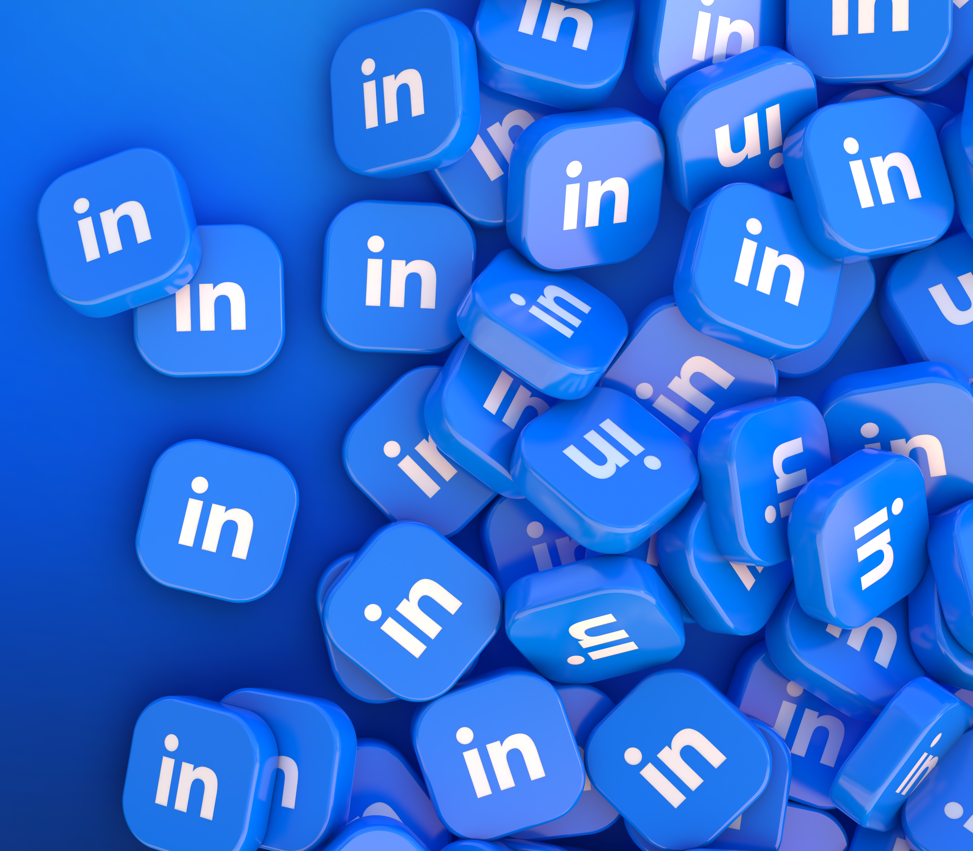
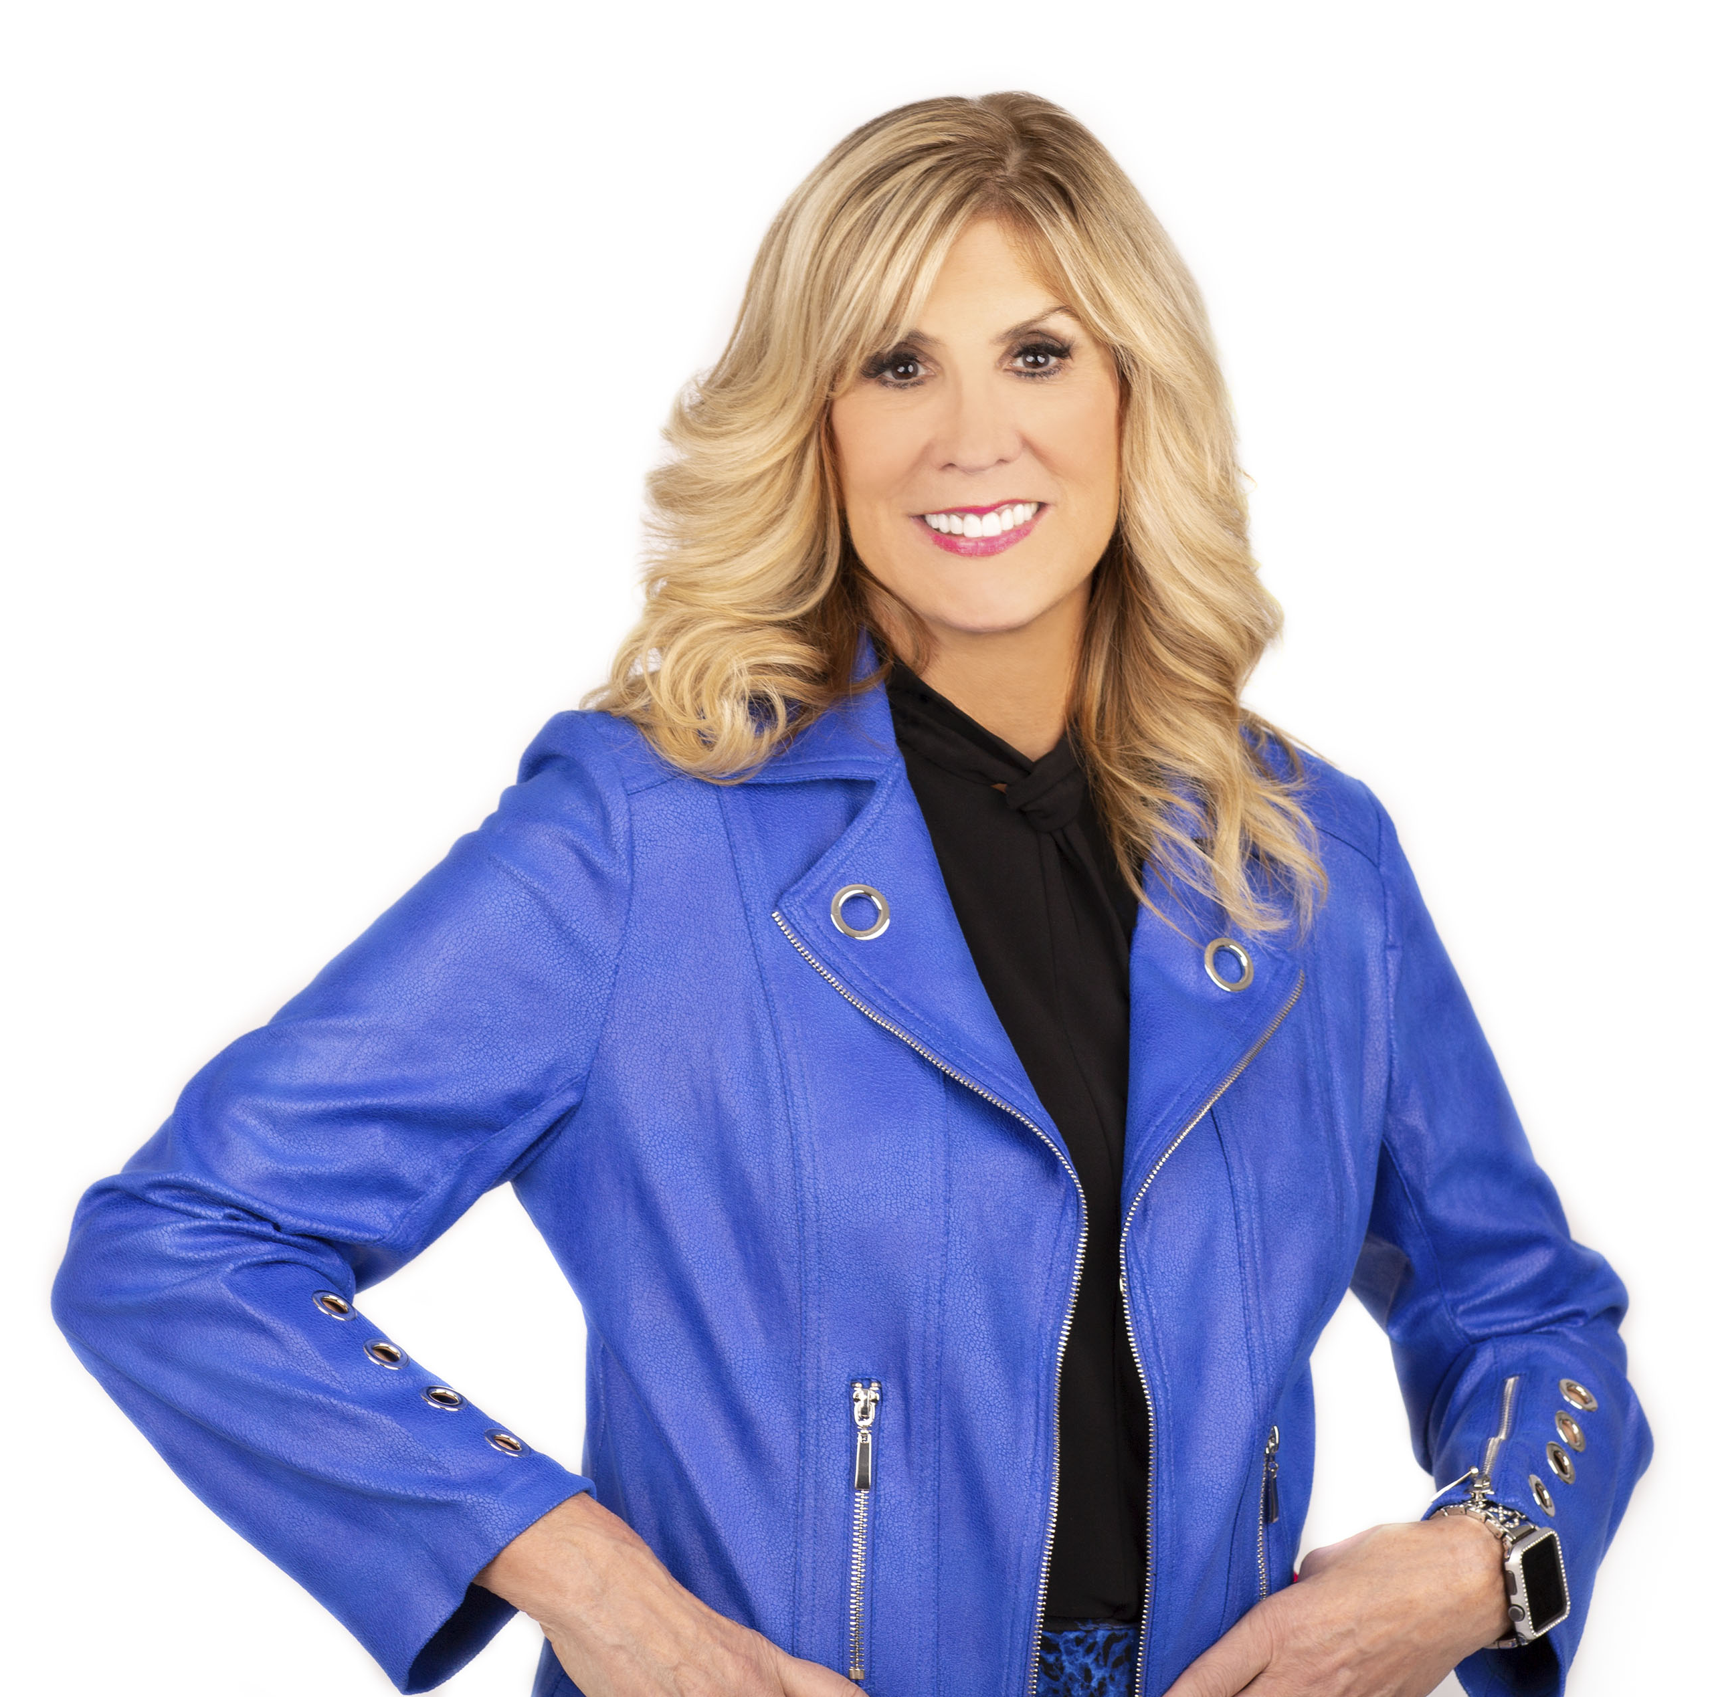
Masterclass for
Clear Beliefs
Presented by:
Rhonda L. Sher,
Founder, The Sher Method and “Linkedin Diva”

Slide 2
Copyright © 2023 Rhonda L. Sher | All Rights Reserved.
No part of this publication may be reproduced, distributed or transmitted in any form or by any means including photocopying, recording, or other electronic or mechanical methods, without the prior written permission of the author, except in the case of brief quotation embodied in critical reviews and certain other non-commercial uses permitted by copyright law.
For permission requests, write to the publisher, addressed
“Attention: Permissions Coordinator,” at the email address below:
Rhonda@theshermethod.com

Slide 3
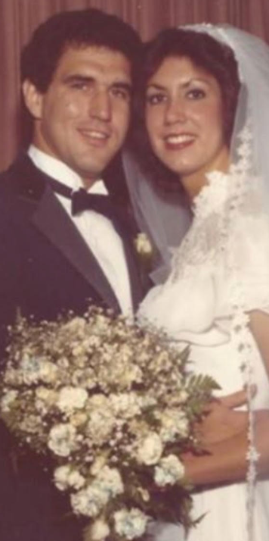
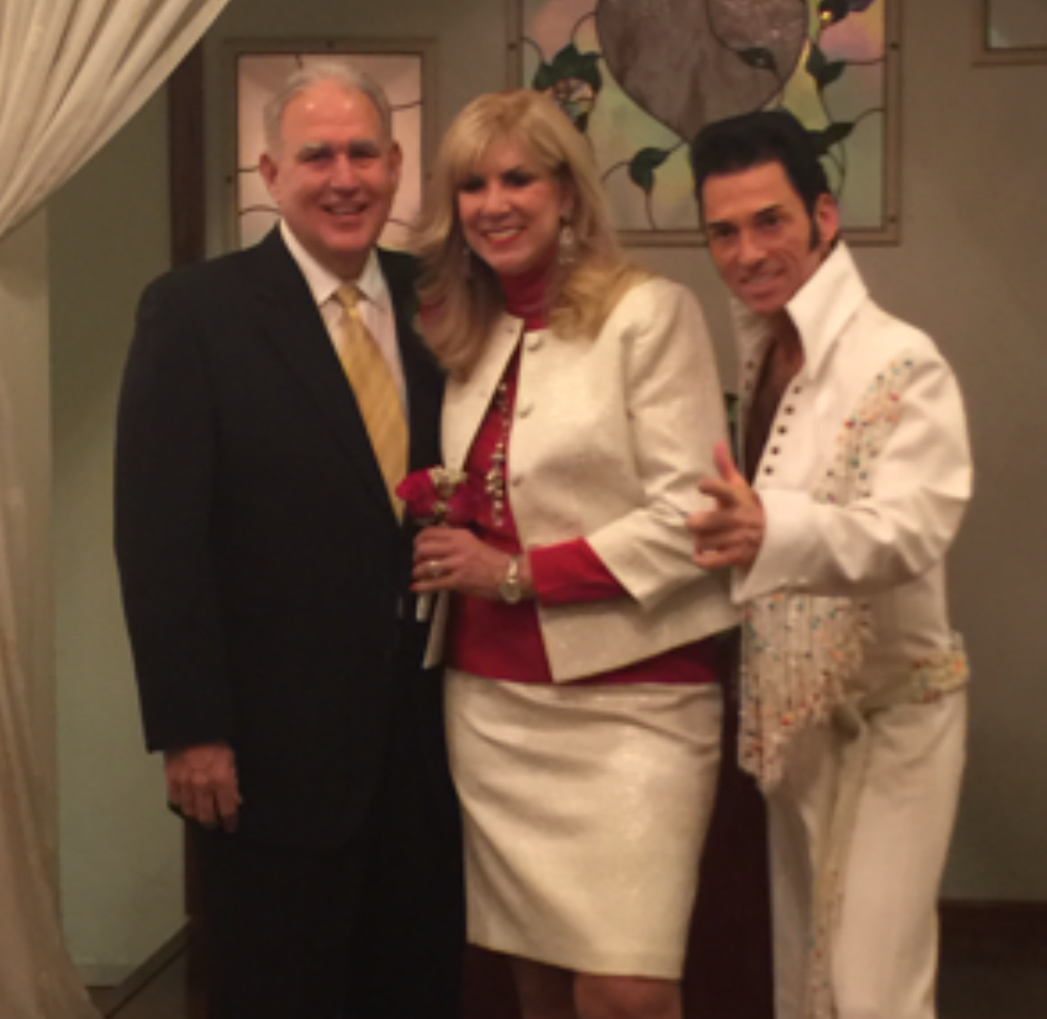
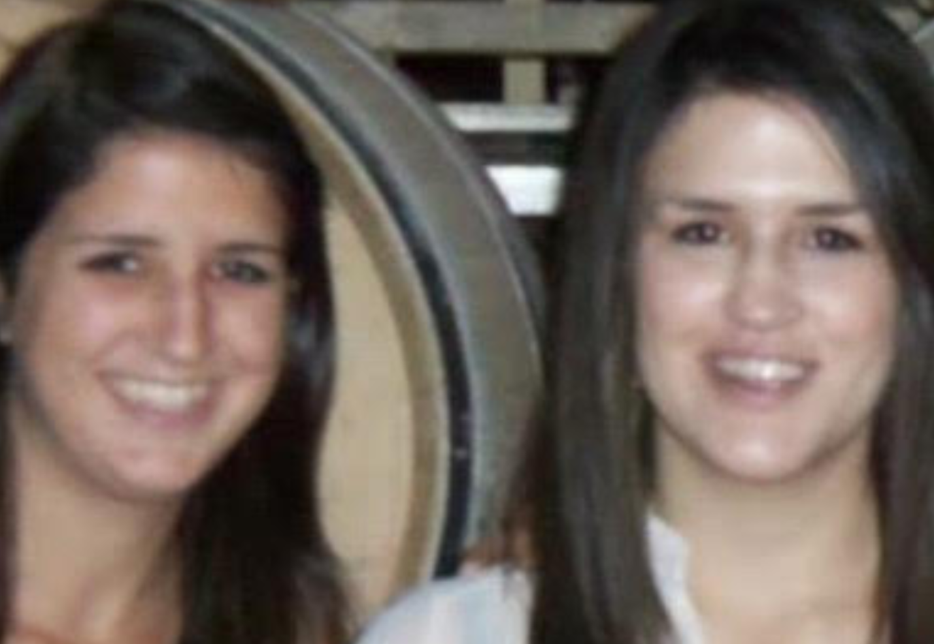
My Story

Slide 4
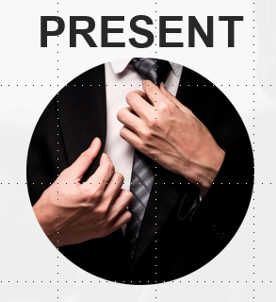
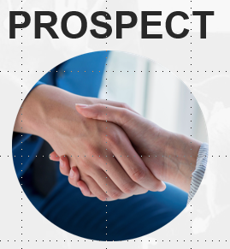
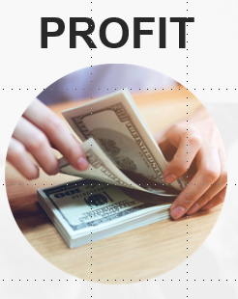
3 Steps to Leverage the Power of LinkedIn to Generate 2-20 Appointments a Week from Posting
POST

Slide 5
Step #1…
PRESENT
on

Slide 6
Why Having an Upgraded LinkedIn Profile is More Important NOW Than Ever
93% of B2B marketers use LinkedIn
65 Million users who are business decision makers
LinkedIn is 277% more effective than Facebook in generating leads
45% of marketers have gained customers through the platform
There are over 850 million people on LinkedIn
Source: Datareportal.com

Slide 7
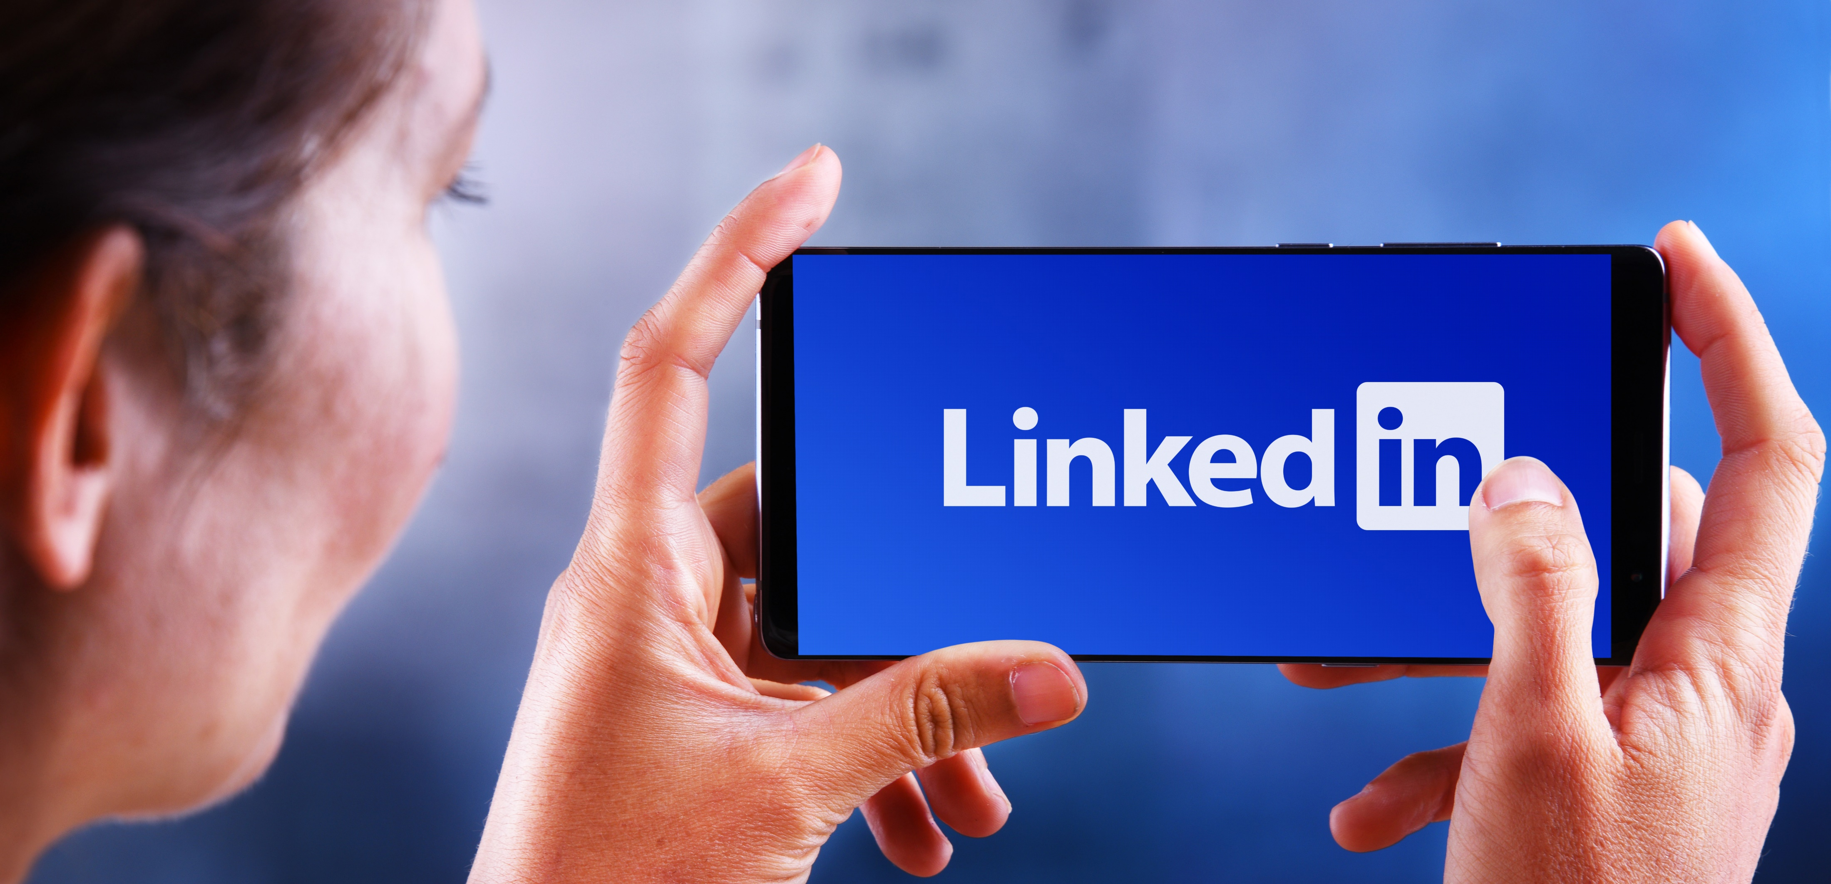
Why Having an Upgraded LinkedIn Profile is More Important NOW Than Ever
To build connections with businesses, referral partners and professionals in your community
To create credibility and visibility
It is the most effective way to prospect today
It is where prospects and referrals go to check you out first
It is often better than your website

Slide 8
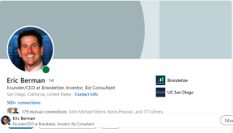
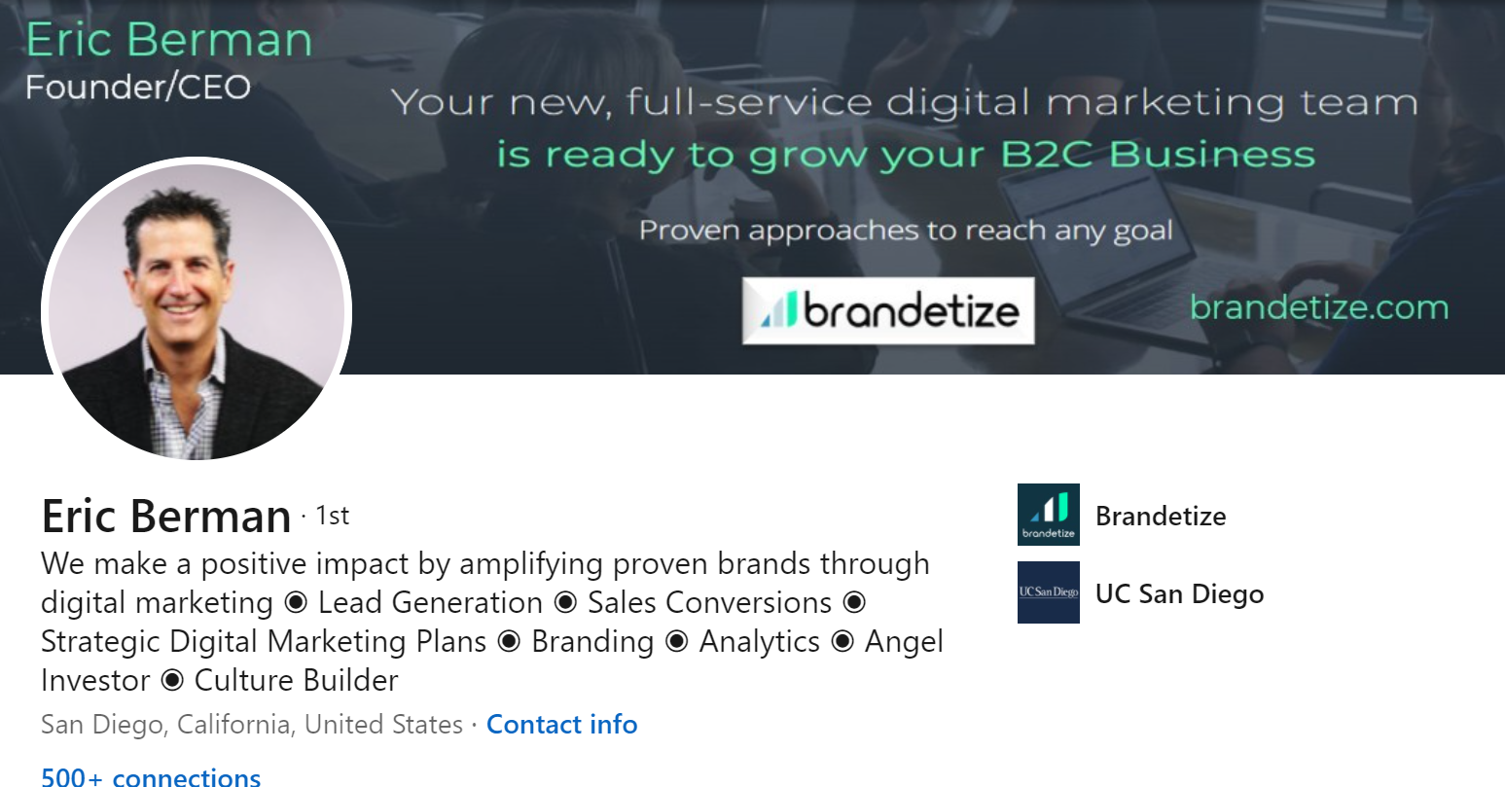
The Problem…
Experts show up on LinkedIn like Amateurs
Amateur
Professional

Slide 9
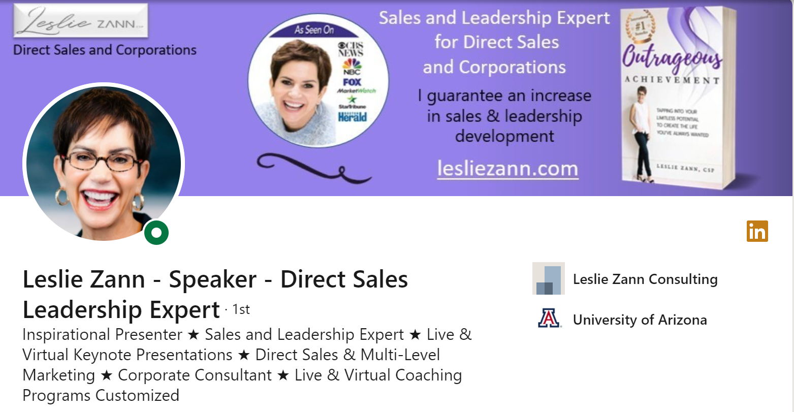
The Solution

Slide 10
LinkedIn = Google Search for Professionals

Slide 11
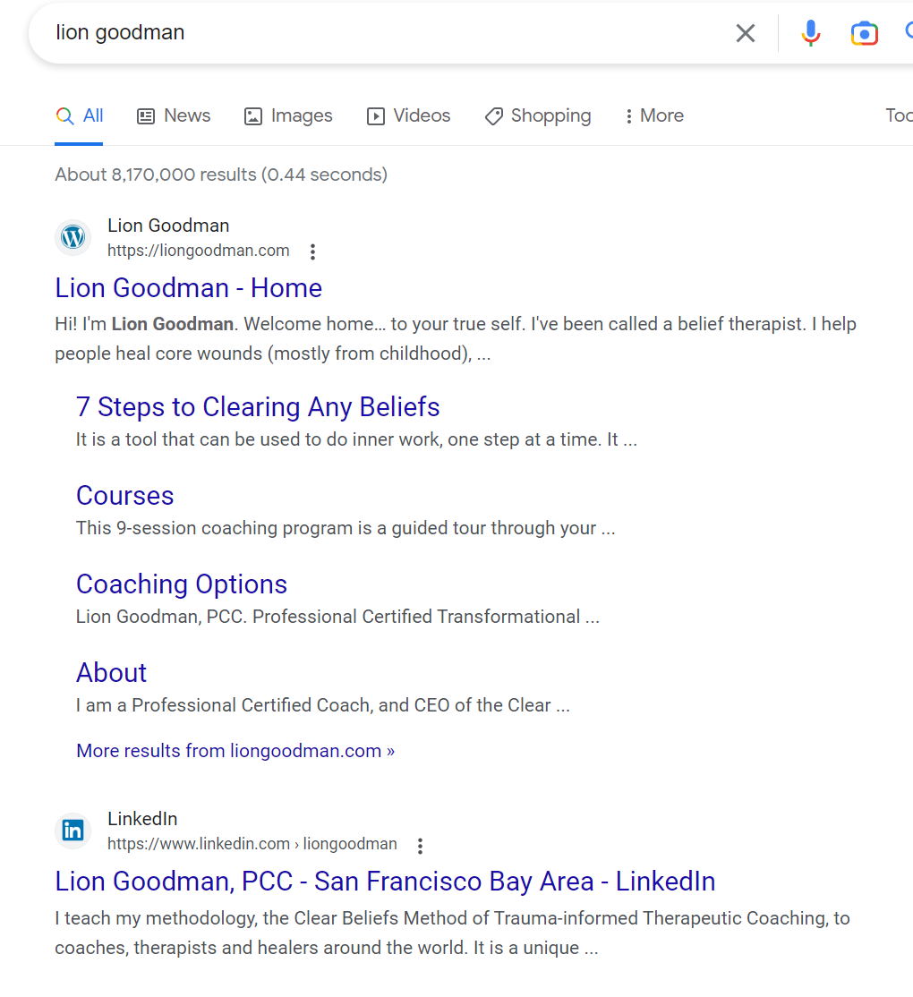

Slide 13
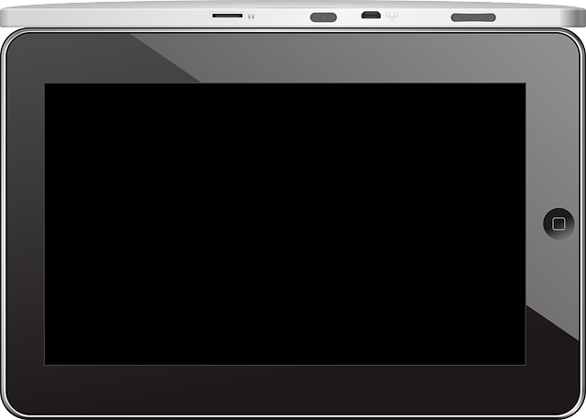
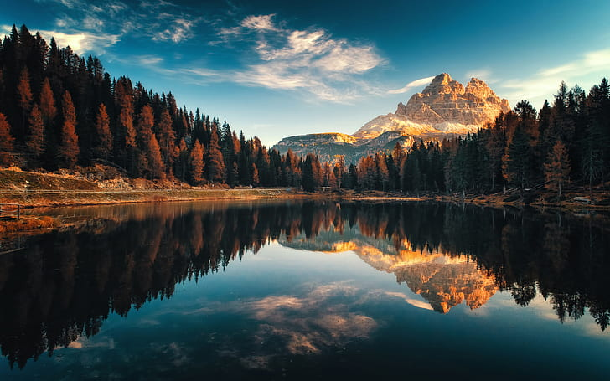
Perception is Everything

Slide 14
Perception is Everything

Slide 15
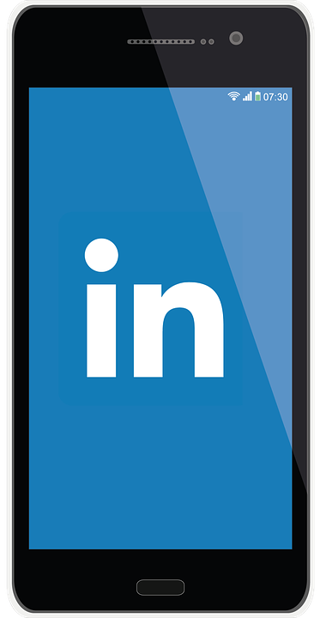
What your LinkedIn profile should contain…
Banner
Professional headshot
Keyword optimized headline
Contact info
Featured section
Experience
Education
Volunteer positions
Publication
Projects
Skills
Recommendations

Slide 16
Step #2…
Posting
on

Slide 17
What You Need to Generate 2-10 Appointments a Week Using Posts
An updated, optimized LinkedIn profile
A system to book appointments on your calendar – Calendly.com – Accuity, BookLike a Boss
An Instagram Account
The LinkedIn app on your phone
30 Minutes a day to devote to LinkedIn
Identifying your ideal prospects or referral partners with whom you want to set appointments

Slide 18
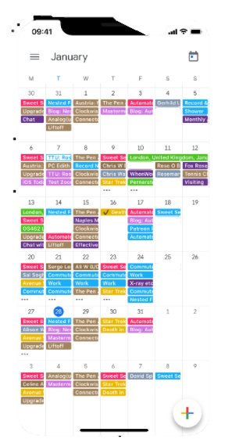
Imagine waking up every day to a calendar filled with appointments

Slide 19
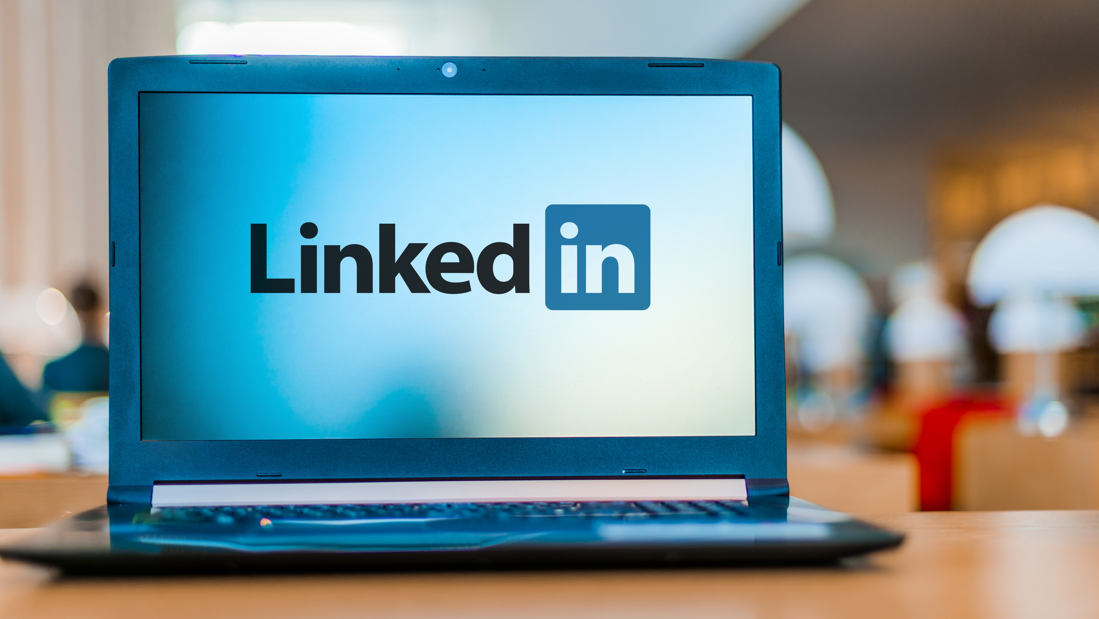
What Can You Post on LinkedIn?
Share something that inspires you – a video/Instagram post/story your read
Answer a common question you get from clients
Share something from your personal life that relates to your business
Create a Top 10 list
Share the story of how you got to where you are

Slide 20
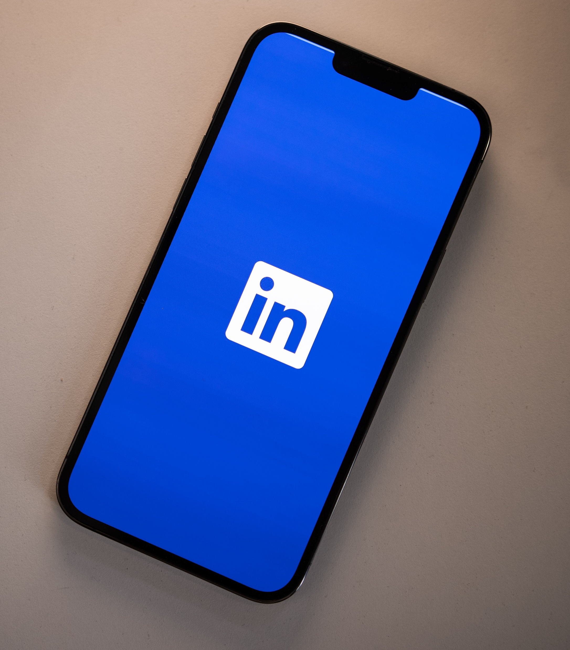
What Can You Post on LinkedIn?
Where were you in life 5 years ago today? 10 years ago? What do you wish you knew back then?
Share your biggest challenge of the week
Share your biggest win of the week
Talk about what is going on in your industry
Share someone post that inspired you
Create a poll

Slide 21
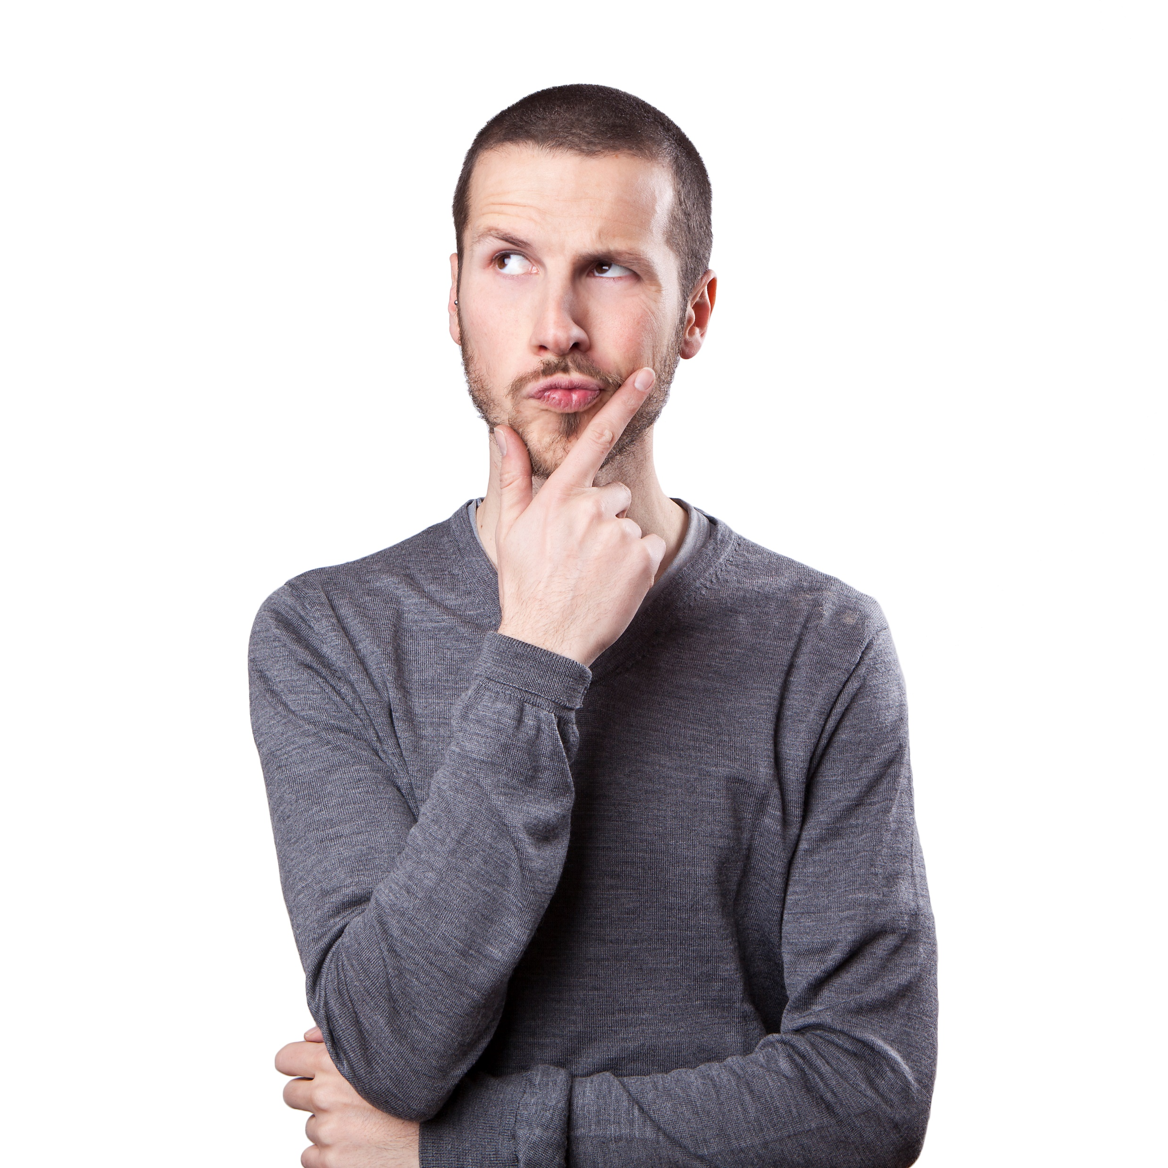
What You Need to Know About Posting
Give engagement to people in your network
Post to attract comments and respond to each comment you receive
“Comments provide more data than likes and re-shares, they also generate engagement. Therefore, many successful authors end their post with a question”
Post consistently, no more than 20 times per month, but no less than three times a week.

Slide 22
How often should you post on LinkedIn?
LinkedIn recommends posting every business day on the platform. Best time is between 8:00 and 10:00 am
My recommendation is to post at least 3 times a week and no more than a once a day
According to HubSpot, after posting more than once a day, engagement significantly drops.

Slide 23
When you consistently
post, comment, like
& share on LinkedIn,
YOU will be
top of mind
with prospects &
referral partners
& establish authority
as the expert
in your field

Slide 24
First Steps
Determine if you will be posting from your desktop/laptop or on your cell phone
If you are doing this from your phone, download and log into the LinkedIn mobile app
The LinkedIn app is either in the app store for iPhone and play store for android phone
Bring up the profile of the person you want to send a message to on your mobile device

Slide 25
Types of LinkedIn Posts
Thought-provoking questions: Posts that ask a question that encourages discussion or debate tend to generate a lot of engagement on LinkedIn.
Industry news and trends: Posts that share news or insights about your industry or profession can generate a lot of interest and engagement from other professionals in your network.
Personal stories: Sharing a personal story that relates to your professional journey or highlights a key lesson or experience can be a great way to connect with your audience on a more personal level.
Inspirational quotes: Posts that include an inspirational or motivational quote can also generate a lot of engagement on LinkedIn, especially if the quote is relevant to your audience's professional lives.
How-to guides and tutorials: Posts that offer practical advice or tips on a specific topic or skill can be very valuable to your audience, and often generate a lot of engagement as a result.

Slide 26
The Steps to Post a Picture on LinkedIn
Log in to your LinkedIn account and go to your LinkedIn homepage
Click on the "Start a post" button that is located at the top of your LinkedIn homepage.
Click on the "Photo" icon, which is located at the bottom left corner of the post box.
Choose the photo that you want to upload from your computer. You can also drag and drop the photo into the post box.
Once you have selected the photo, you can add a caption to the post by typing in the text box.
You can also tag people or companies by typing "@" and then the name of the person or company.
Click on the "Post" button to share the picture on LinkedIn.

Slide 27
Who Do You Set Appointments With?
People you are connected to and/or you share common interests or connections with (This is a get to know you better appointment)
People who follow the same people that you do (influencers or people in your industry)
People that you want to get to know and are not yet connected with
Extend a personalized connection request first before you ask for an appointment (highly recommended)
Thank the new connection for accepting your request before you ask for an appointment

Slide 28
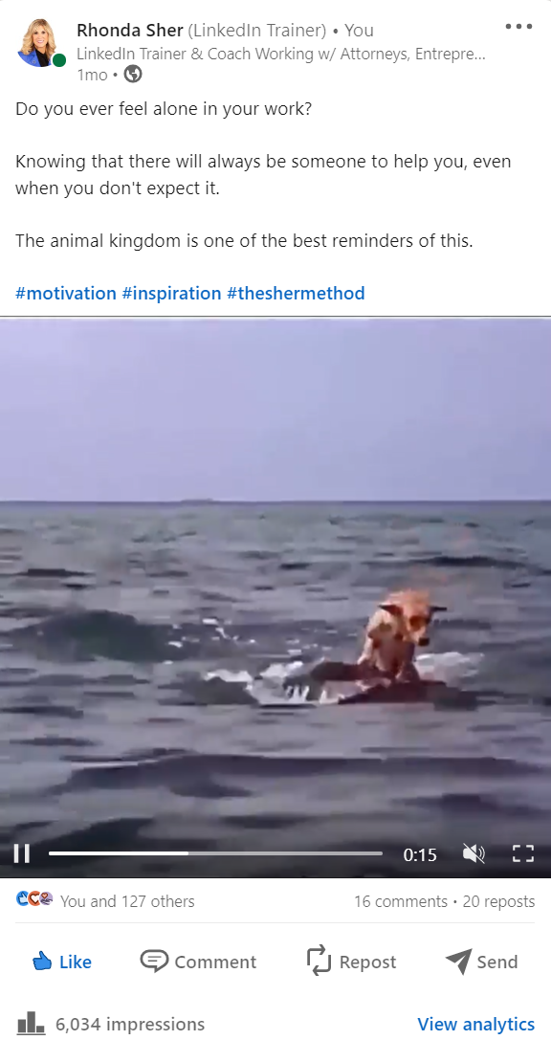
Posting
Sharing
Liking
Commenting
127 Likes – 16 comments – 20 reposts

Slide 29
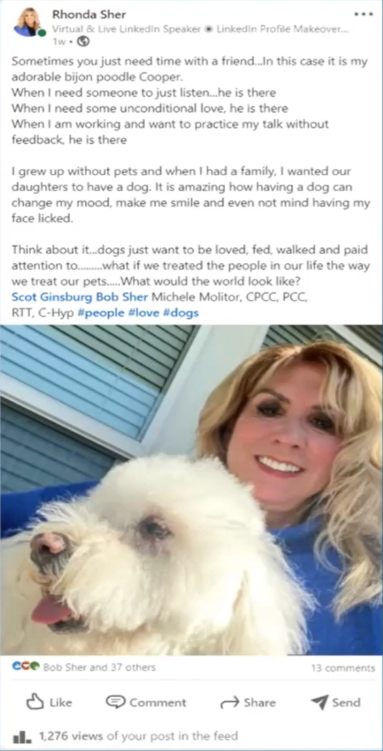
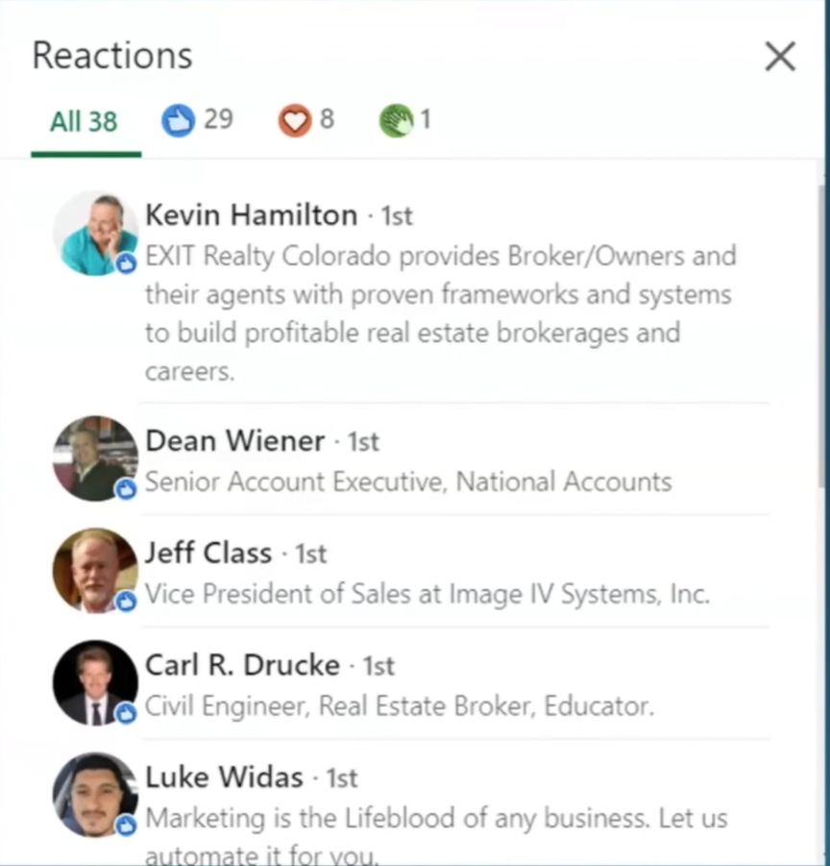

Slide 30
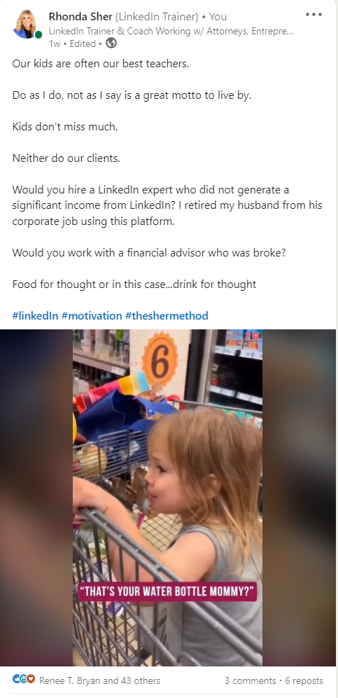
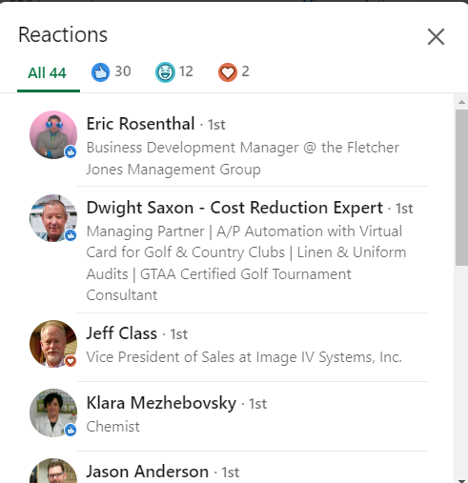
Educational
Motivational
Inspirational
Humorous
That’s your water bottle mommy

Slide 31
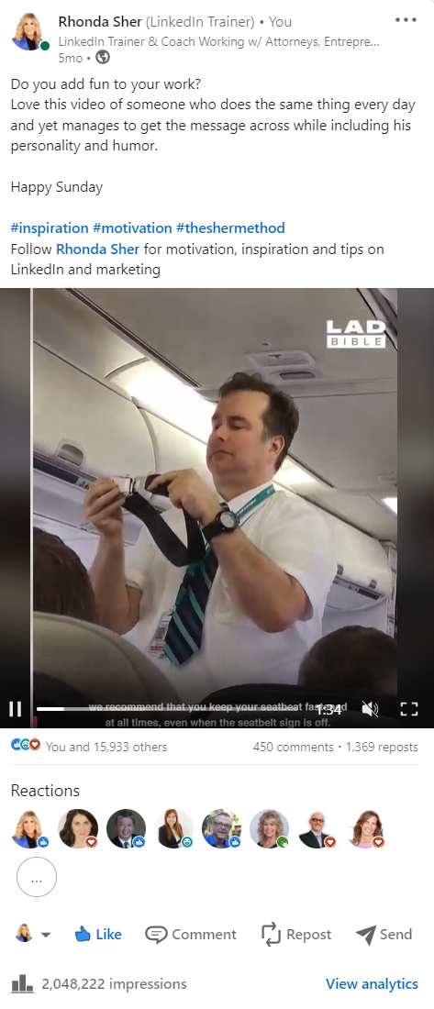
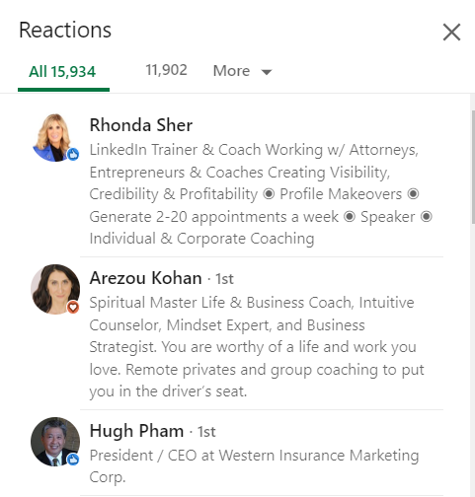
Over 2 Million Views
15,933 Likes – 450 Comments – 1369 Reposts
One post with the right strategy can generate hundreds of appointments

Slide 32
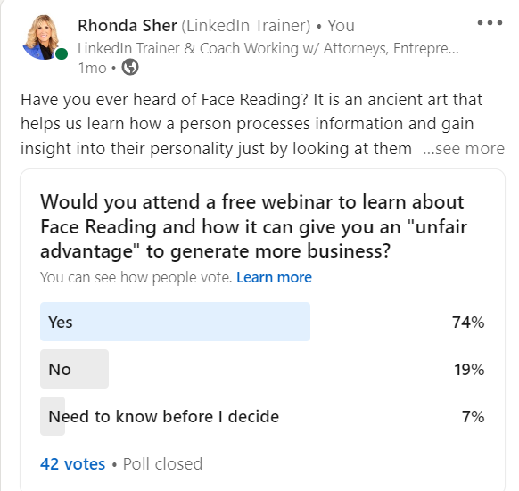
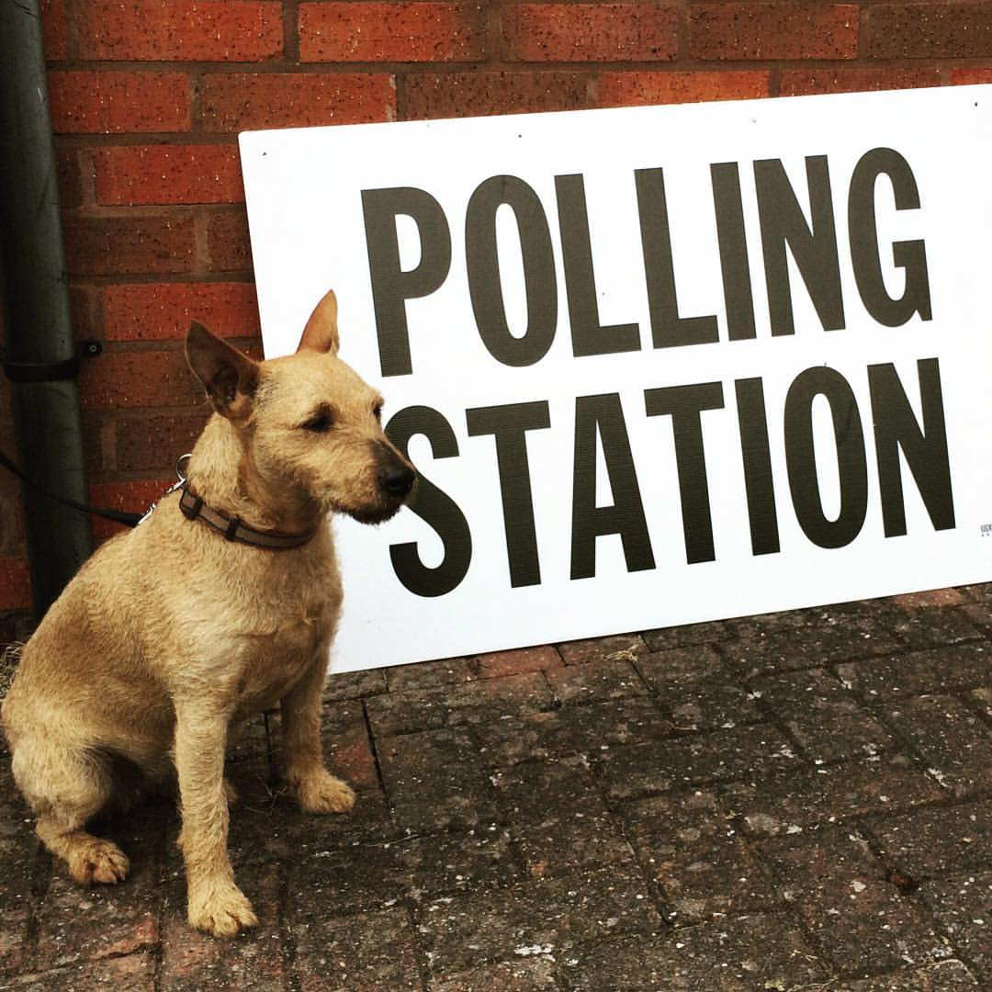
Polls are a great way to use posts to generate leads

Slide 33
Contact Me – Rhonda Sher
Phone 760 515-2822
Email linkedindiva@gmail.com
LinkedIn URL www.linkedinrhonda.com
Training
Online Courses and Boot Camps
Coaching for individuals and groups
Mastermind
Speaking

Slide 34
Let’s Look at LinkedIn
Real life examples of how this works

Slide 35
In Gratitude

